Slide 1
Graph Data Structure
Introduction to Graphs
A graph is a non-linear data structure consisting of vertices (nodes) and edges that connect these vertices. It's one of the most versatile data structures used to model real-world relationships and networks.

Slide 2
Formal Definition
A graph G is an ordered pair G = (V, E) where:
V = Set of vertices (nodes)
E = Set of edges (connections between vertices)

Slide 3
Types of Graphs
Based on Edge Direction
Undirected Graph: Edges have no direction (bidirectional)
Directed Graph (Digraph): Edges have specific directions
Mixed Graph: Contains both directed and undirected edges
Based on Edge Weight
Unweighted Graph: All edges have equal weight/importance
Weighted Graph: Edges have associated weights/costs
Based on Structure
Simple Graph: No self-loops or multiple edges
Multigraph: Allows multiple edges between vertices
Complete Graph: Every vertex connected to every other vertex
Cyclic Graph: Contains at least one cycle
Acyclic Graph: No cycles (e.g., Tree)

Slide 4
Graph Interpretations
The use of a graph may be an easy simplification for a problem.
Example: Apartment Blueprint: The vertices could represent rooms in a house, and the edges could indicate which of those rooms are connected to each other.
Living Dinning
Room
Hall
Bed
Kitchen Bath
Living Room Dinning Bedroom
Kitchen Hallway Bath
Friendship Graphs: Each vertex represents a person, and each edge indicates that the two people are friends.
Sitotaw
Dawit
Almaz
Tamrat
Zewditu
Petros
Notes:
Our question might be, how can I get from the Kitchen to the bathroom while going through the fewest other rooms?

Slide 5
Types of Graph
a
d
  A simple graph is one that contains no loops or parallel edges
    Parallel edges are edges where more than one edge connects two given vertices,
  A multigraph is a graph that contains multiple edges.
  A complete graph is a simple graph in which every pair of vertices is adjacent, that is, the graph contains all possible edges.
b
e
c
f
a
d
b
e
c

Slide 6
1. Simple Graphs
A simple graph G is a pair (V,E), where
  V is a set of vertices (representing the objects)
  E is a set of edges, where each edge in E is a set of 1 or 2 vertices (representing the links between vertices)
G = (V,E), where
V = {a,b,c,d,e,f}
E = {{a,b},{a,c},{b,c},{b,d},{b,e},{c,f},{e,f}}
a
d
b
e
c
f

Slide 7
2. Multigraphs
A multigraph G is a pair (V,E), where
  V is a set of vertices (representing the objects)
  E is a bag of edges, where each edge in E is a set of 1 or 2 vertices (representing the links between vertices)
G = (V,E), where
V = {a,b,c,d,e}
E = {{a,b},{a,c},{a,c},{a,c},{b,c},{b,d},{b,d},
{b,e}}
a
d
b
e
c
A bag, or multiset, is a set in which repeated elements are allowed

Slide 8
3. Directed Graphs
A directed graph G is a pair (V,E), where
  V is a set of vertices (representing the objects)
  E is a set of edges, where each edge in E is an ordered pair of vertices (representing the links between vertices)
a
d
b
G = (V,E), where
V = {a,b,c,d,e,f}
E = {(a,b),(b,e),(c,a),(c,b),(c,f),(d,b),(f,e)}
e
c
f
Note: the order in the ordered pair matters.
(a,b) and (b,a) are different edges

Slide 9
4. Complete graphs
A complete graph is one where every vertex is adjacent to every other vertex.
Complete graphs:
Not complete graphs:
Exercise: if a complete graph has n vertices, how many
edges does it have?

Slide 10
Vertex degree
The degree of a vertex, v, is the number of times edges are incident on v (where an edge from v to itself counts twice)
a
d
G = (V,E), where
V = {a,b,c,d,e,f}
E = {{a,b},{a,c},{b,c},{b,d},{b,e},{c,f},{e,f}}
b
e
c
f
The degree of vertex a is 2, and degree of vertex b is 4.
The function deg:V→N returns the degree of any vertex.

Slide 11
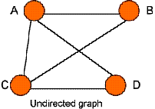
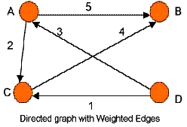
Forms of a Graph
Directed and undirected graphs:
  A directed graph (digraph) is one in which the direction of any given edge is defined.
  In an undirected graph, G, one can move in both directions between vertices. The pairs (u, v) and (v, u) represent the same edge
Weighted or unweighted graphs:
  A graph is said to be weighted if each edge has an associated number (weight). Otherwise, it is unweighted graph.

Slide 12
Individual Assignment (10 %)
Graph representations
  Adjacency matrix
  Adjacency list
  Adjacency multilist

Slide 13
Graph Traversals
Given a graph, one of the fundamental graph problems is to traverse every edge and vertex in a graph so as to:
  count the number of edges
  identify connected components of a graph.
Goal: visit all (or some) vertices and edges of the graph using some strategy (the order of visit is systematic)
Depth First Search (DFS) and Breadth First Search (BFS) are examples of graph traversals. The order of exploring the vertices depends upon the data structure used:
  Queue: by storing the vertices in a queue, BFS explores vertices following FIFO order. Thus, it explores starting the initial vertex level by level.
  Stack: by storing the vertices in a stack, DFS explores vertices following LIFO order. Thus, it constantly visit a new neighbor depth-wise.
Some shortest path algorithms and spanning tree algorithms have specific visit order.

Slide 14
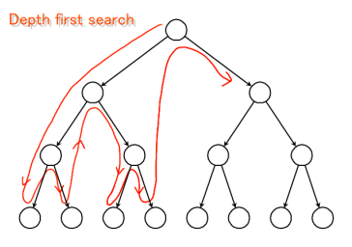
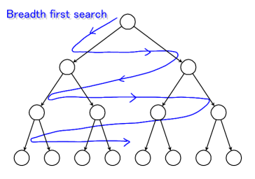
Graph Traversals
In DFS, as each vertex v is visited, all of it’s children are added to front for immediate processing
Use of a stack leads to a depth-first visit order. Stack is used to keep track of: nodes to be visited next, or nodes that we have already visited.
In BFS, as each vertex v is visited all of it’s unvisited children are kept in a waiting list
Use of a queue leads to a breadth-first visit order. Queue is used to keep track of: nodes to be visited next, or nodes that we have already visited.

Slide 15
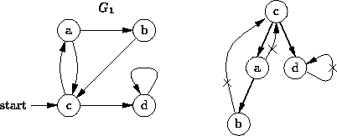
Depth-First Traversal
Strategy: Go as far as you can (if there is unvisited node depth-wise); otherwise, go back and try another way
The depth-first traversal visits the nodes in the order -
c, a, b, d
Remark:
A depth-first traversal only follows edges that lead to unvisited vertices.
if we omit the edges that are not followed, the remaining edges form a tree.

Slide 16
DFS: Algorithm
procedure DFS( v )
  visited (v) = 1; //Mark v as visited
  For each vertex u adjacent to v do
    If (visited (u) = 0) then //if vertex u is unvisited
      DFS(u)
end
procedure GraphTraversal()
  for i = 1 to n // n is the number of vertices v
    visited(v_{i}) = 0; //Mark v as unvisited
  for i = 1 to n
  if (visited(v_{i}) = 0)
    DFS(v_{i})
end

Slide 17
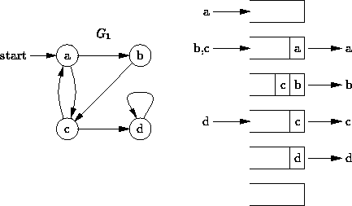
Breadth-First Search (BFS)
In DFS, we choose the most recently visited vertex to expand. Where as, BFS explores the vertices in the order of their distance from the start vertex level-wise.
  BFS examines every path of length i before going on to paths of length i+1.
BFS visits the nodes in the order: a, b, c, d

Slide 18
BFS: Algorithm
procedure BFS( v )
  visited (v) = 1; //Mark v as visited
  enqueue(v)
  do{
    for all vertices u adjacent to v do
      If visited(u) = 0
        visited(u) =1 enqueue(u)
    v = dequeue()
  }while queue is not empty
end
procedure GraphTraversal()
  initialize visited(v) = 0; //Mark v as unvisited
  for i = 1 to n // n is the number of vertices v
  if (visited(v_{i}) = 0)
    BFS(v_{i})
end

Slide 19
Time complexity
Proof: Depending on the graph representation, time complexity for DFS and BFS is the same:
  If Adjacency matrix : O(V²)
  If Adjacency list : O(V + E)

Slide 20
Applications in Real World
Social Networks: Friend recommendations, influence analysis
Transportation: Route optimization, traffic management
Computer Networks: Routing protocols, network topology
Web: PageRank algorithm, web crawling
Biology: Protein interaction networks, phylogenetic trees
Recommendation Systems: Collaborative filtering
Project Management: Critical path analysis

Slide 21
Key Takeaways for Algorithm Design
Choose appropriate representation based on graph density and operations needed
Consider graph properties (directed/undirected, weighted/unweighted, cyclic/acyclic)
Optimize for specific operations (shortest path, connectivity, flow)
Balance time vs space complexity based on constraints
Use appropriate data structures (heaps for priority queues, union-find for MST)

Slide 22
Exercise
Show the order of traversing the following graphs using DFS and BFS starting from node 1
1
2
4
  DFS: 1→2→5→6→3→7→4
  BFS: 1→2→3→4→5→6→7
3
5
6
7
1
2
3
  DFS: 1→2→4→8→5→6→3→7
  BFS: 1→2→3→4→5→6→7→8
4
5
6
7
8

Slide 23
Exercise
Show the order of traversing the following graphs using DFS and BFS starting from node 1
1
2
3
  DFS: 1→2→4→8→5→6→3→7
  BFS: 1→2→3→4→5→6→7→8
4
5
6
7
Fig 1
8
1
2
4
  DFS: 1→2→5→6→3→7→4
  BFS: 1→2→3→4→5→6→7
3
Fig 2
5
6
7

Slide 24
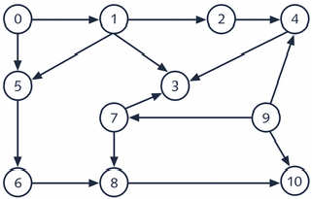
Exercise
Find the order of traversing the following graphs using DFS and BFS
Start at node 0
D
Start at node A
G
B
J
H
E
K
C
I
A
F
L

